Slide 1

Welcome
Global health
Session 8
Dr. Tilly Paz

Slide 2

In this session you will:
Familiarise with the various global actors and possible partnerships for better global health
Understand the various conflicts and interests possible in global health partnerships
Unpack the last section of your essay and benefit from peer feedback

Slide 3
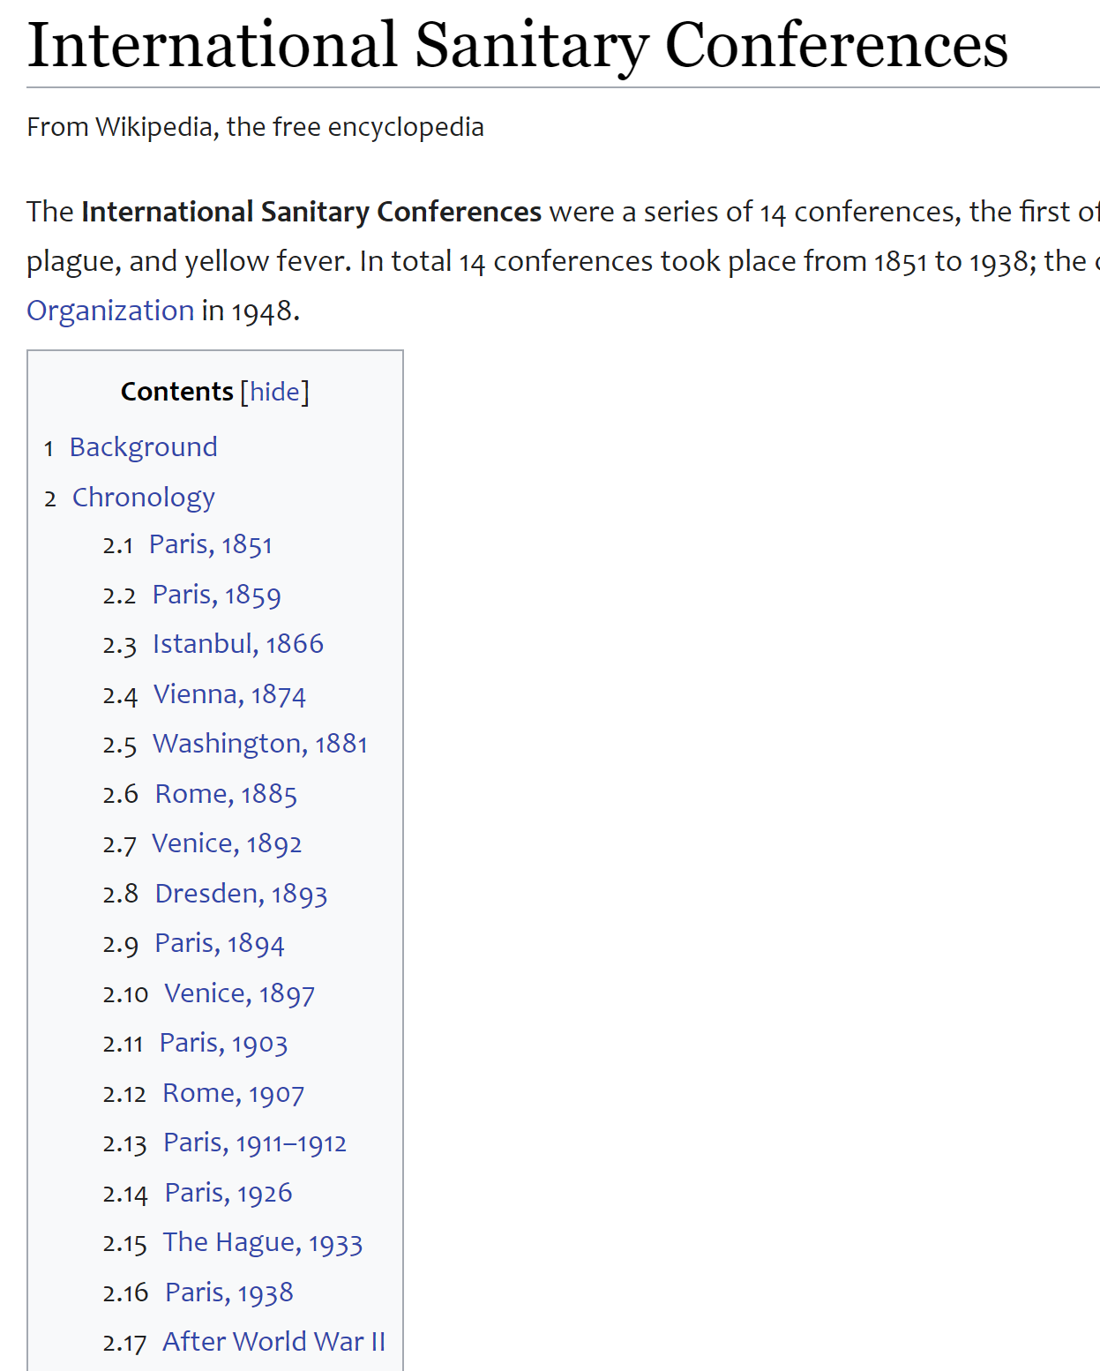
Trends in Global Health Efforts
Cooperating in global health is not new
Threat of cholera led to the first international conference on health in 1851 (focus on sanitary and regulations of quarantine)
At first, international cooperation focused on the surveillance of disease, the provision of global standards for drugs and vaccines, and selected technical advice to countries on key health matters, including medical education

Slide 4
Trends in Global Health Efforts
Establishment of UN agencies after World War II shifted efforts to focusing on building capacity for global public health efforts, for health systems development in countries that were newly independent, and working together to fight disease
Many global conferences led to a shift in family planning from almost exclusively focusing on limiting family size to an approach that centered much more on reproductive health
What makes family planning an interesting and relevant PH and GH issue around WWii?

Slide 5
Trends in Global Health Efforts
In 1978, the Alma Ata declaration on primary healthcare was meant to lead to a greater global focus on the needs of the poor, greater attention to ensuring health systems could deliver primary care, and community-based approaches
As the world moved into the late 1980s and early 1990s, concern arose over the unfinished agenda, vertical approaches to addressing them, and the need for health sector reform

Slide 6
Trends in Global Health Efforts
The 1993 Development Report of the World Bank articulated the need for cost-effectiveness analysis, becoming a foundation for actions of many key actors
Toward the mid 1990s, the global health community began paying more attention to HIV/AIDS and other major killers of the poor in low-resource countries, such as malaria and TB

Slide 7
Trends in Global Health Efforts
More recently, efforts driven by the MDGs and SDGs focus on nutrition and maternal health, in addition to polio eradication, NTDs, and developing health systems to provide universal coverage
Much attention is also being paid to how development partners and countries can work together to achieve these aims and how to finance investments in times of economic distress
What can partners gain from creating GH partnerships?
Notes:
Neglected tropical diseases

Slide 8
Cooperating to Improve Global Health
Creates a consensus around a cause
Strengthens advocacy efforts
Allows knowledge sharing and standard setting
Many aspects of global health are “global public goods”
Enhances surveillance to stem disease outbreaks
Assists in more effective financing of health efforts

Slide 9

Who could be a GH partner? Which sector?

Slide 10
Key sectors acting for global health
Agencies of the united nations
Multilateral development banks
Foundations and trusts
Global NGOs
Research/Advocacy/Think tanks/Consulting firms
WHO related partnerships
Public private partnerships
Private sector and businesses

Slide 11

Assessing global health partnerships
Looking at the critical paper: Assessing how global health partnerships function: an equity-informed critical interpretive synthesis
Katrina M. Plamondon, Ben Brisbois , Leslie Dubent and Charles P. Larson

Slide 12
Playing with partnerships
In your group, examine the global health issue given to you
Identify the main challenges
Identify the main needs
Decide who would be the senior partner in order to solve/make progress with the issue
Invite 4 more partners from different sectors to join the effort:
Who are they? (please write their name on the big sheet under the sector they belong to)
What can they bring to the table?
Where could be a conflict of interest between the 4 of you? How could it affect the work and the expected progress?

Slide 13
GH issues
https://www.who.int/news-room/fact-sheets/detail/asthma
https://www.who.int/news-room/fact-sheets/detail/breast-cancer
https://www.who.int/news-room/fact-sheets/detail/suicide
https://www.who.int/news-room/fact-sheets/detail/cholera
Use this resource to find out more global context about your essay topic
https://www.who.int/news-room/fact-sheets

Slide 14
Key Actors in Global Health
Agencies of the United Nations
WHO—World Health Organization
UNICEF—United Nations Children’s Fund
UNFPA—United Nations Population Fund
UNDP—United Nations Development Programme
UNAIDS—Joint United Nations Program on HIV/AIDS
Notes:
Split up

Slide 15

Key Actors in Global Health
WHO
United Nations agency that is responsible for health
Headquartered in Geneva and has offices in each region of the world
Primarily a technical agency that engages in knowledge sharing and plays a key role in setting technical standards and norms
Priority Action Areas: Health for all; Health emergencies; Women, Children, and adolescents; The health impacts of climate and environmental change

Slide 16

Key Actors in Global Health
UNICEF
The main function of UNICEF is to enhance the health and well-being of children
UNICEF is headquartered in New York but has offices in 190 countries
All of UNICEF’s funding is from voluntary contributions
Focus areas: Child protection and inclusion; Child survival; Education; Children in complex emergencies; Gender; Innovation for children

Slide 17

Key Actors in Global Health
UNAIDS
Global agency with primary responsibility for dealing with HIV/AIDS
Based in Geneva
Assists countries with national AIDS plans, works to strengthen country surveillance, emphasizes prevention, and works to increase the number of people on treatment

Slide 18
Key Actors in Global Health
Multilateral Development Banks
African Development Bank, the Asian Development Bank, the Inter-American Development Bank, and the World Bank
Owned by their member countries
Lend or grant money to countries to promote economic and social development
Main focus: to serve as financial intermediaries

Slide 19
Key Actors in Global Health
Foundations
The Rockefeller Foundation
The Wellcome Trust
The UN Foundation
The Clinton Foundation
The Bill & Melinda Gates Foundation
Notes:
Add more information

Slide 20

Key Actors in Global Health
The Rockefeller Foundation
Strength is investing a relatively small amount of money to make large impacts
In last 20 years, established the framework for developing partnerships between the public and private sectors in GH and worked on HIV/AIDS and human resources in poor countries
Now focus on universal health coverage, food security, and further leveraging the private sector

Slide 21

Key Actors in Global Health
The Wellcome Trust
Supports biomedical research globally to understand health and disease
Funds research conducted either at independent institutions or institutes created by the foundation and improves facilities in low-income countries
Well known for sequencing one third of the human genome and uncovering genetic links to cancer and diabetes

Slide 22

Key Actors in Global Health
The Bill & Melinda Gates Foundation
Supports global development work
Reducing health inequities
Improving access to health products and services
Market-based solutions to inclusive and sustainable economic development
Build partnerships to promote supporting policies
Funds scientific discoveries and supports partner organizations

Slide 23
Key Actors in Global Health
Research Funders
Focus on doing and funding research
Gates Foundation, Wellcome Trust, Howard Hughes Medical Research Institute
U.S. National Institutes of Health, National Health and Medical Research Council of Australia, and others supported by national governments

Slide 24
Key Actors in Global Health
Nongovernmental Organizations (NGOs)
Most raise money from private sources or receive grants
Vary from small to very large and secular to faith-based
Examples of the most important international NGOs in health: BRAC, Catholic Relief Services, Doctors without Borders, and Partners in Health

Slide 25
NGOs
Many INGOs – International NGOs are involved in a range of activities including relief aid, development work, advocacy, logistics while also engaging in clinical care and research
Most large NGOs raise funds from individuals, private foundations and governments sources
One major difficulty can be balancing the interests of the donors and the recipients

Slide 26
NGOS
It is vital that NGOS consider the social and political impact of their actions
Well intentioned efforts can sometimes have harmful implications for recipient communities
NGO presence can sometimes exacerbate conflicts or encourage displaced people to remain in an area which then becomes more dangerous

Slide 27
NGOs
However a large number of NGOS manage to navigate these potentially volatile minefields well
Many have worked in communities for long periods of times
They have built strong relationships
NGOs can also provide a link between communities and international development organisations
Jacobsen (2014)

Slide 28




NGOs
Some NGOs are faith based organisations sponsored by religious groups – while nowadays they don’t expect recipients to adhere to a particular faith – they do represent the various religious traditions
World Vision
Islamic Relief
Catholic Relief services
World Jewish Relief

Slide 29

Key Actors in Global Health
BRAC
Largest NGO involved in international development and reaches 135 million people
Works in areas of human rights and social empowerment, education and health, economic empowerment and enterprise development, livelihood training, environmental sustainability and disaster preparedness
Women and children take priority
Well known for reducing child and infant mortality, spreading oral rehydration therapy, and effectiveness of community-based approaches
In Bangladesh, its community-based approach to primary health care is called Essential Health Care (EHC)
Trained community healthcare workers are known as shasthya shebika

Slide 30

Key Actors in Global Health
Doctors Without Borders (MSF)
Umbrella organization made up of affiliated groups in 21 countries
Best known for provision of health services following humanitarian crises, but also involved with nutrition, disease control efforts, and also efforts to increase access to essential medicines
Commitment to political independence, medical ethics, and human rights

Slide 31
Key Actors in Global Health
Advocacy Organizations
Carry out research and policy studies
Use this evidence to engage in advocacy activities for key stakeholders, the public at large, funding agencies, national legislatures, and governments
May be aligned with specific issues, such as the Global Network on Tropical Diseases
ONE Campaign, RESULTS, and the Global Health Council address a range of issues

Slide 32
Key Actors in Global Health
Think Tanks and Universities
Think tanks focus on generating knowledge on key issues; e.g., Center for Global Development or the Results for Development Institute
Many universities have become involved in teaching, research, and practice on global health issues and often create institutes or centers to bring researchers together; e.g., Yale Institute for Global Health

Slide 33

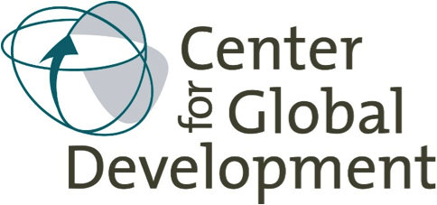
Think tanks and universities
Eg Centre for Global Development ( Washington)
https://www.cgdev.org/
Has an extensive research programme on global health/ publishes on global health and hosts a variety of seminars to disseminate knowledge
The Results for Development Institute- Washington
Think thank actively involved in research on policy and program issues in global health
Research on financing HIV / AIDs
Universal health coverage
Innovative approaches to addressing key global health issues
http://www.r4d.org/

Slide 34
Key Actors in Global Health
Consulting Firms
For-profit and not-for-profit
Either address a range of issues, such as financing or policy, or have a particular area of expertise, such as supply chain management or behavior change communications
Often development assistance from agencies is channeled through consulting firms

Slide 35
Key Actors in Global Health
Specialized Technical Organizations
Best known example is the CDC
Assists with planning and carrying out surveillance, prevention, and control across a broad range of disease conditions
Also provides technical assistance for disease control programs to build capacity in low- and middle-income countries

Slide 36
Key Actors in Global Health
Public-Private Partnerships
Framework encouraged by Rockefeller Foundation
Seek to combine the strengths of public and private organizations in a common quest for better health
Conceived of as “venture capital firms” that would have a social goal rather than a goal that was mostly aimed at maximizing profit

Slide 37
Public private partnerships
Global Fund to fight AIDS, Malaria and TB (GFATM)
Global Alliance for Vaccines and Immunisation (GAVI)
Global Alliance for Improved Nutrition (GAIN)
Roll Back Malaria (RBM)
Stop TB Partnership (Stop TB)
International AIDS Vaccine Initiative (IAVI)
Medicines for Malaria Venture
Notes:
Foundation for innovative new diagnostics ( FIND)
Health Metrics Network (HMN)

Slide 38
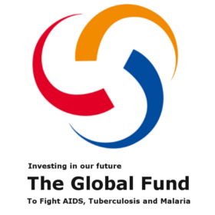
Global Fund to fight AIDS, TB and malaria
Established in 2002
Established due to increasing global concern about HIV/ AIDs and a recognition that measures to address HIV/ AIDs epidemic had been insufficient.
Partnership of public and private sectors – WHO , UNAIDS and World Bank are key partners
Primarily a financing agency – engages in advocacy and policy work for global health
Finance proposed investments in these diseases
Skolnik (2016 p.455)
Notes:
Also assists countries in improving the efficiency of their procurement of equipment , supplies drugs related to programmes for HIV / AIDs / TB malaria

Slide 39

Global Alliance for Vaccines and Immunisation (GAVI)
Created in 2000, GAVI
Is an international organisation - a global Vaccine Alliance, bringing together public and private sectors with the shared goal of creating equal access to new and underused vaccines for children living in the world’s poorest countries
http://www.gavi.org/about/

Slide 40

Global Alliance for Improved Nutrition (GAIN)
GAIN is an international organization driven by the vision of a world without malnutrition.
Around 3.5 billion people — half the people on the planet today — are malnourished.
The Global Alliance for Improved Nutrition (GAIN) is focused on finding solutions to end malnutrition within our lifetimes.
http://www.gainhealth.org/about/
Notes:
Each year, malnutrition kills 3.1 million children under the age of five and leaves 159 million stunted, trapping generations in lives of poverty and unfulfilled potential.

Slide 41

Roll Back Malaria (RBM)- partnership related to WHO
RBM's vision is of a world free from the burden of malaria.
By 2020, all countries and partners accelerate their efforts. Malaria mortality rates and incidence is reduced by at least 40% compared with 2015. Malaria does not re-emerge in countries that were malaria-free in 2015.
Malaria is eliminated in a further 10 countries compared to 2015.
http://www.rollbackmalaria.org/about-rbm/rbm-vision
Notes:
By 2015, the malaria-specific Millennium Development Goal (MDG) is achieved, and malaria is no longer a major cause of mortality and no longer a barrier to social and economic development and growth anywhere in the world.

Slide 42

Stop TB Partnership – related to WHO
The Stop TB Partnership is leading the way to a world without tuberculosis (TB), a disease that is curable but still kills three people every minute.
Founded in 2001, the Partnership's mission is to serve every person who is vulnerable to TB and ensure that high-quality diagnosis , treatment and care is available to all who need it.
http://www.stoptb.org/about/

Slide 43
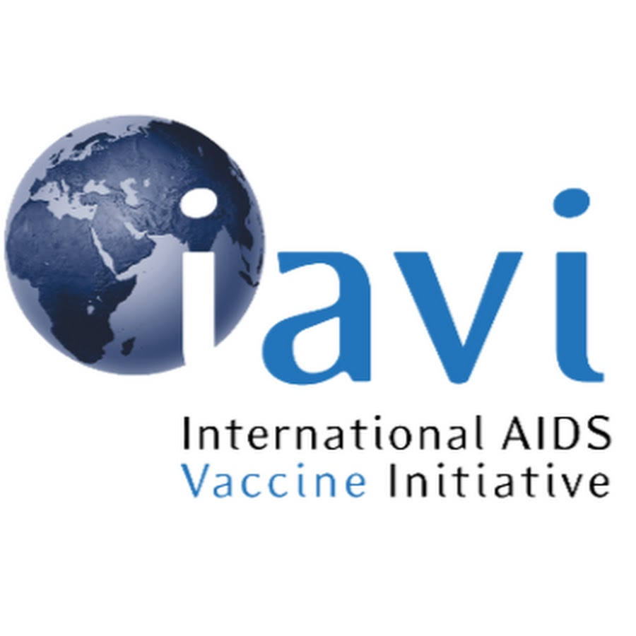
International AIDS Vaccine Initiative
https://www.iavi.org/

Slide 44

Medicine for Malaria venture
https://www.mmv.org/
MMV is a leading product development partnership (PDP) in the field of antimalarial drug research and development.
Our mission is to reduce the burden of malaria in disease-endemic countries by discovering, developing and facilitating delivery of new, effective and affordable antimalarial drugs.
Our vision is a world in which these innovative medicines will cure and protect the vulnerable and under-served populations at risk of malaria, and help to ultimately eradicate this terrible disease.

Slide 45
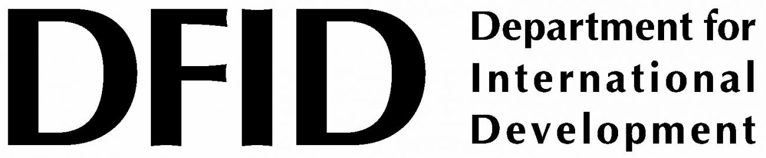

Bilateral agencies
Mainly development assistance agencies of high income countries that work directly with low and middle income countries eg
IN UK – DFID- Dept for International Development
Japan – Japan International Cooperation Agency ( JICA)
USAID – Agency for International Development alongside the Dept of State, Peace Corps, US Dept of Defence, US Dept of the Treasury
Many of these are coordinated by the US Global Health Initiative ( GHI)
http://www.ghi.gov/
Notes:
See Pg 300 Jacobsen ( 2014) Table 12-5 for list of International development Agencies acronyms
Dutch Agency for Development Cooperation
Australian Agency for International Development
Danish International Development Agency

Slide 46

Specialised technical organisations
Specialists in global health
US Centres for Disease Control and Prevention (CDC)
Part of the US Department of Health and Human Services
Involved in helping the US and other countries to plan and carry out disease surveillance, prevention and control across a broad range of disease conditions
CDC staff collaborate with many countries in work on communicable disease control programmes such as HIV/ TB and malaria
Skolnik (2016 p. 453)

Slide 47

Pharmaceutical firms
Many pharmaceutical companies donate drugs and other products valued at more than $1 billion
Most of the major drug companies have programmes for donation of retroviral drugs for HIV / AIDS and many of the companies make donations in the areas of TB, malaria and tropical diseases, preventable diseases , maternal and child health issues, chronic diseases or emergency relief
Jacobsen (2014) Skolnik (2016)
Notes:
Some companies have made investments in particular diseases

Slide 48
Businesses
Some companies make in-kind donations and fund global health programs through their own foundations as part of their corporate and social responsibility plans
However these are not always without rewards for these companies
As it is often humanitarian aid, it is tax deducted- these donations help international markets and promote these brands in new markets, populations with increased income and lower expenditures on health will have more money to spend on other services
Jacobsen (2014 p.290)
Notes:
These companies can expand their markets
See Skolni 2016 p. 457

Slide 49
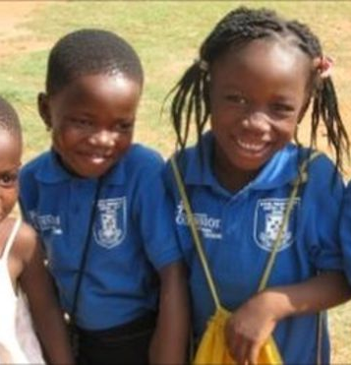
Personal donations
Millions of individuals make donations to global health activities
This is often most obvious after major disasters
Child sponsorship schemes run by World Vision, Save the Children among many others are also very popular forms of donation
Jacobsen (2014 pp.290-291)
Notes:
US Red Cross received $200 million dollars donations following Japan tsunami in 2011 and $300 million dollars following the Haiti earthquake 2010

Slide 50
Future Challenges
Increased burden of non-communicable diseases
Cooperative surveillance and prevention and treatment of emerging and reemerging conditions
Working together to strengthen weak health systems
Addressing knowledge gaps that prevent progress in preventing and treating AIDS, TB, malaria, and NTDs
Further leveraging public-private partnerships
Financing important initiatives
Continuing good leadership in the global health community
Focusing on evidence-based actions and results

Slide 51
Bibliography
Birn, A E, Holz,T., Pillay, Y (2018) Textbook of Global Health. Oxford: University of Oxford.
Jacobsen, KH ( 2014) Introduction to Global Health (2nd ed) Burlington, MA: Jones and Bartlett Learning
Johnson, J., Stoskpopf, C and Shi, L (2018) Comparative Health Systems: A Global Perspective (2nd ed). Burlington, MA: Jones and Bartlett.
McCracken, K., and Phillips D.R., (2012) Global Health : An Introduction to current and future trends. Oxon : Routledge
Skolnik, R ( 2016) Global health 101 ( 3rd Ed) . Burlington, MA: Jones and Bartlett Learning

Slide 52
Essay time!
The last question/section is about how the lessons learned could be relevant to two other countries
A quick Google search of your topic and images. For example: Malnutrition globally by country
Use images to detect which countries are relevant and research those for the best fit
Look for the prevalence of the problem, who is affected, why
Similarities with the case study country that might make the intervention work
Differences from the case study which may become a barrier (political, cultural, geographical, economical etc.)
Possible mini-structure: ~200 words to describe the lessons learned (you can come up with your own ideas!); ~400 words for each country (half for similarities and half for barriers)

Slide 53
Essay time #2
Give your printed page to a friend
You each read and make as many comments as possible
Reflect on the feedback and write down what you still need to do
Hand the plan and the comment sheet to me to benefit from more feedback next week

Slide 54

See you next week
Next week we will talk about some of the social determinants of health from a global perspective, and provide some group feedback about the essay plans
Please bring with you the list of 20 super fantastic academic references for your essay, if you haven’t done so already

